Slide 1
FPGAs – Part 2: Interconnects and hardwired resources
CE233(CAD), Lecture 6:
Mehdi Modarressi
Department of Electrical and Computer Engineering,
University of Tehran

Slide 2
Reading:
  Spartan-3 Generation FPGA User Guide, Xilinx ug331 (v1.8)
  “FPGA Prototyping By VHDL Examples- Xilinx Spartan-3 Version”, Chapter 2
  “The Design Warrior's Guide to FPGAs”, Chapter 4

Slide 3
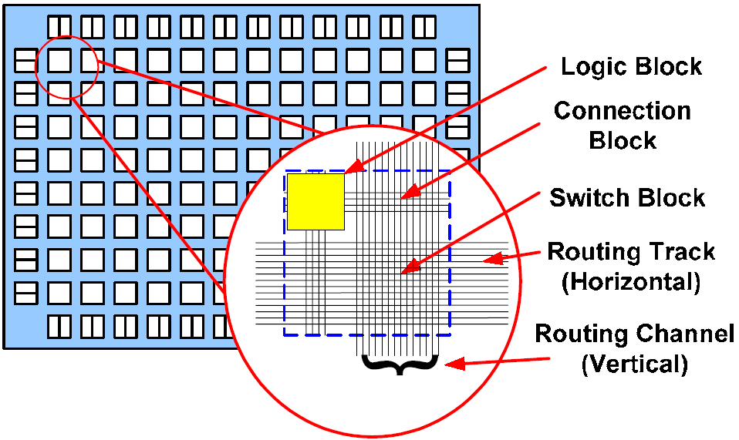
FPGA interconnects

Slide 4
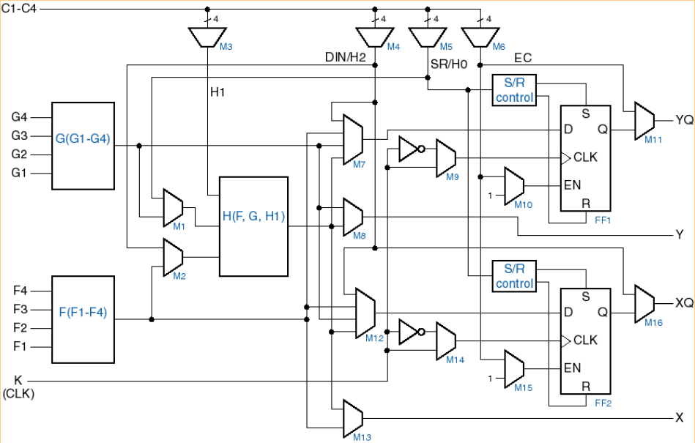
FPGA interconnects- connection box
How to connect CLB to wires?
Solution: connection box
  Device that allows inputs and outputs of CLB to connect to different wires
Connection box
CLB
CLB

Slide 5
Connection box
Connection box characteristics
  Topology
    Defines the specific wires each CLB I/O can connect to
    Examples: same flexibility, different topology
CLB
CLB
CLB
CLB

Slide 6
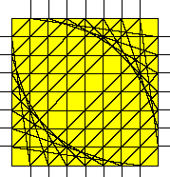
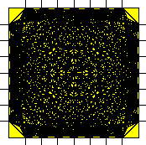
FPGA interconnects- switch box
Switch Blocks connect horizontal and vertical channels
A trade-off between flexibility and switch size
Fs = 3, the most common switch
Low flexibility, good size
Fs = n-1=6: too big but very flexible

Slide 7
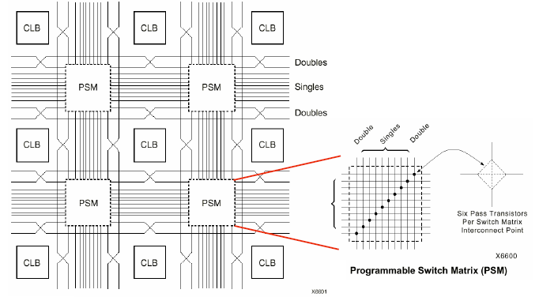
XC4000 interconnects
Fs=3, why?

Slide 8
Switch Matrix Operation
Before Programming
After Programming
6 pass transistors per switch matrix interconnect point
Pass transistors act as programmable switches
Pass transistor gates are driven by configuration memory cells

Slide 9
FPGA interconnects
Connect Logic Blocks using wires and Programmable Switches

Slide 10
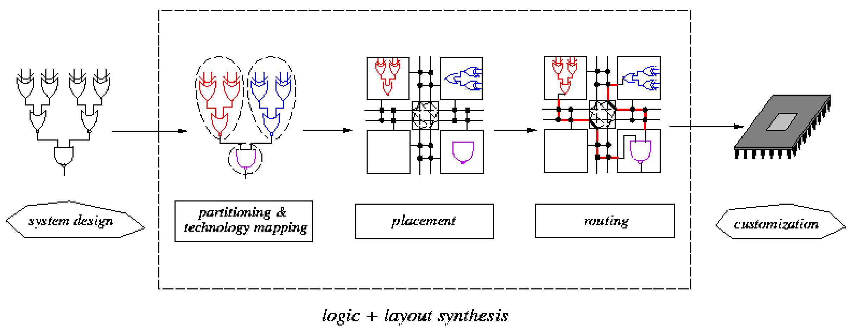
Digital design flow for FPGAs
VHDL
…..
…..
…..
Design entry
Logic synthesis
Partitioning
Placement
Routing
Physical Design (Layout Synthesis)

Slide 11
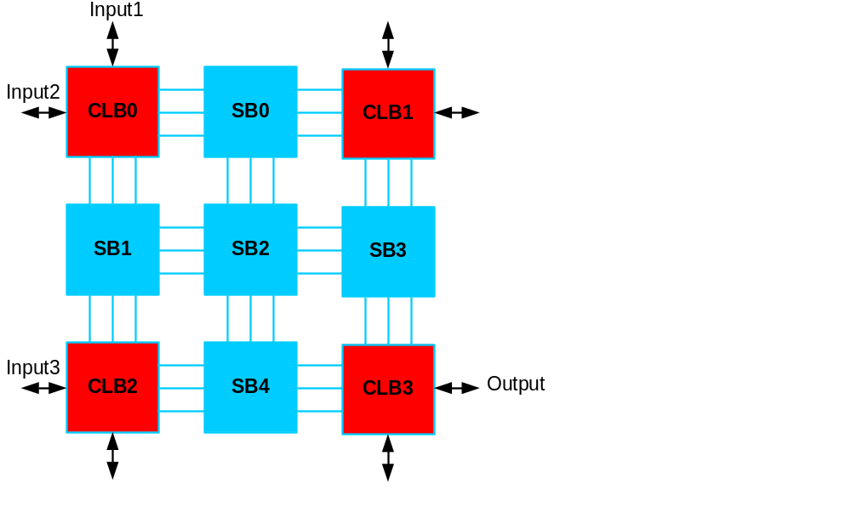
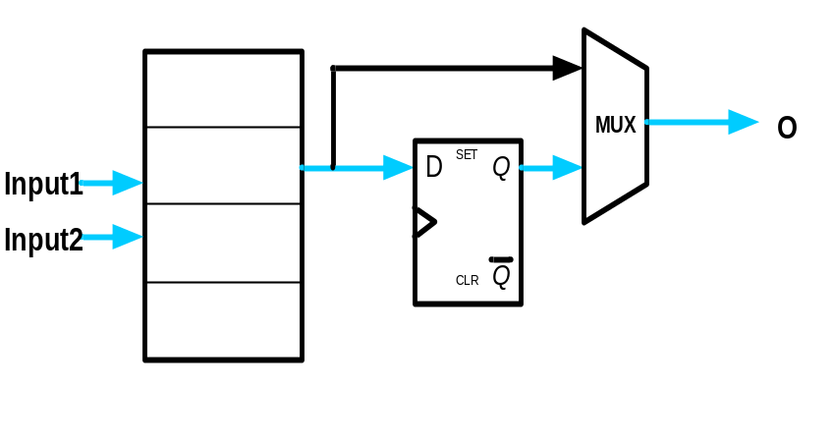
Example
Determine the configuration bits for the following circuit implementation in a 2x2 FPGA, with I/O constraints as shown in the following figure. Assume 2-input LUTs in each CLB.

Slide 12
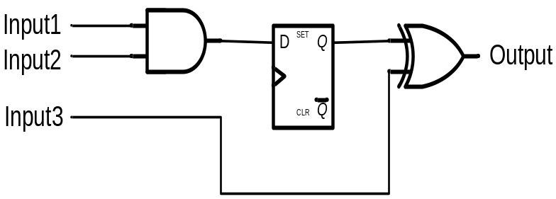
CLB structure
Determine the configuration bits for the following circuit implementation in a 2x2 FPGA, with I/O constraints as shown in the following figure. Assume 2-input LUTs in each CLB.

Slide 13
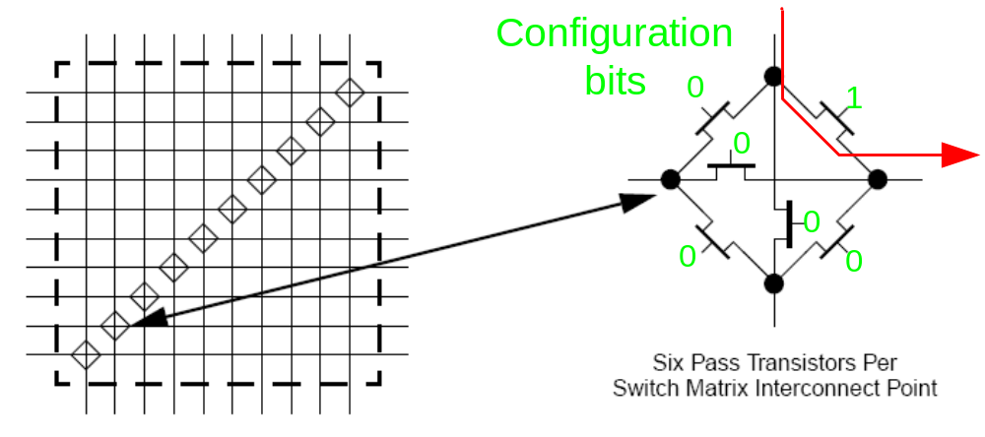
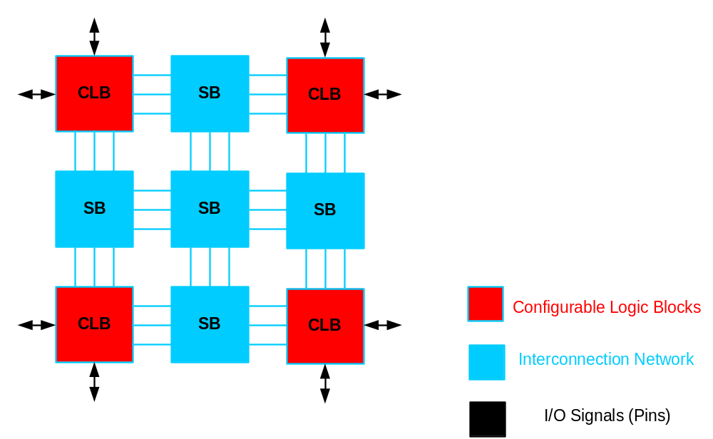
Switch box structure
Slides taken from Antonio R. Miele Marco D. Santambrogio Politecnico di Milano

Slide 14
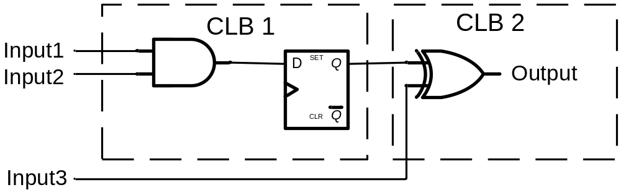
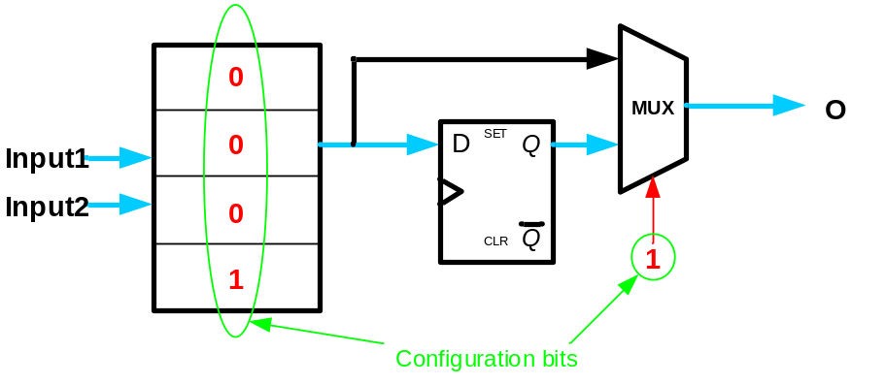
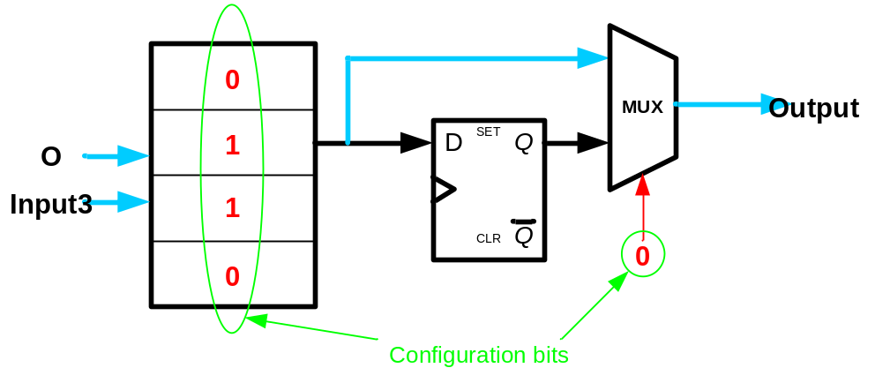
CLBs configuration

Slide 15
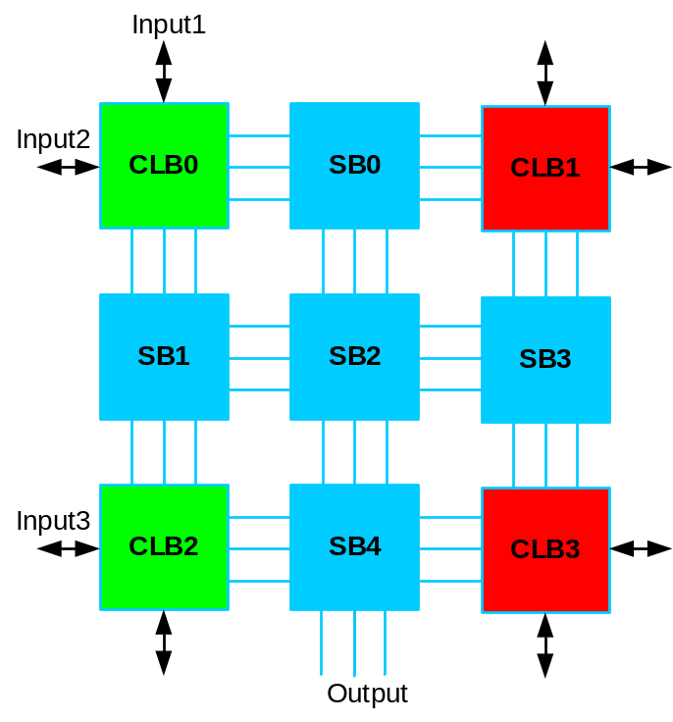
Placement: Select CLBs
CLB0: 00011
CLB1: ?????
CLB2: 01100
CLB3: XXXXX
SB0: 000000
SB1: 000010
SB2: 000000
SB3: 000000
SB4: 000001

Slide 16
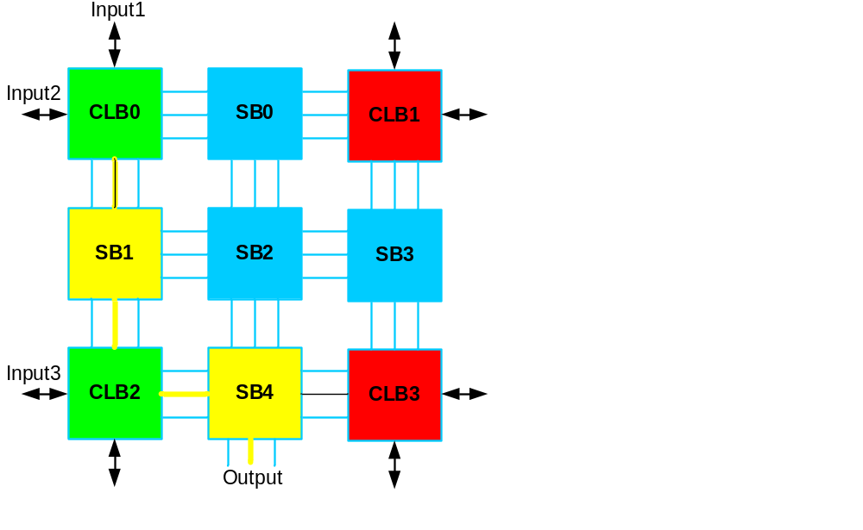
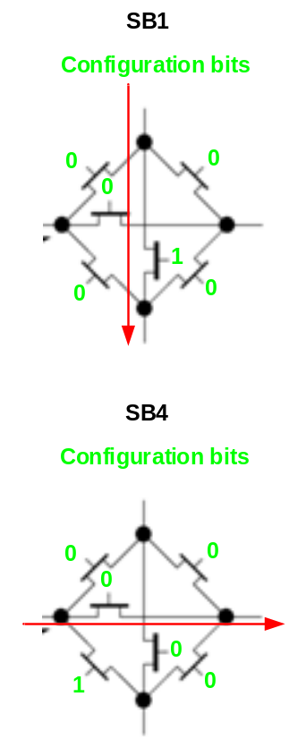
Routing: Select path
CLB0: 00011
CLB1: ?????
CLB2: 01100
CLB3: XXXXX
SB0: 000000
SB1: 000010
SB2: 000000
SB3: 000000
SB4: 000001

Slide 17
Configuration Bitstream
The configuration bitstream must include ALL CLBs and SBs, even unused ones
CLB0: 00011
CLB1: ?????
CLB2: 01100
CLB3: XXXXX
SB0: 000000
SB1: 000010
SB2: 000000
SB3: 000000
SB4: 000001

Slide 18
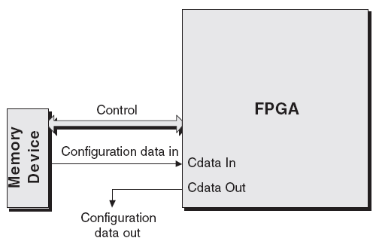
FPGA configuration
The bit-stream is loaded into the FPGA serially through some special input pins

Slide 19
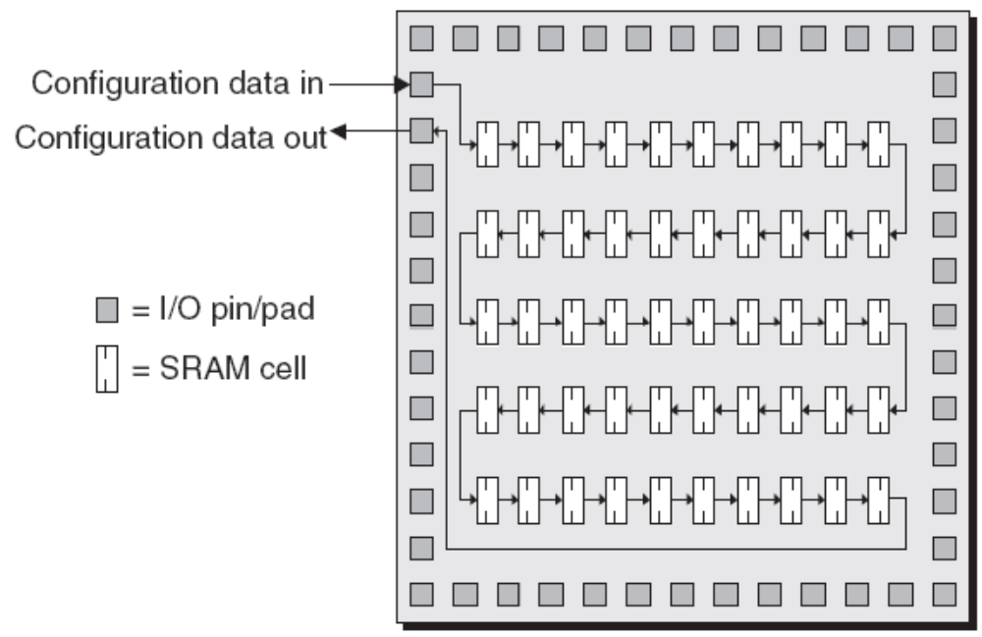
FPGA configuration
All of the SRAM configuration cells as comprising a long shift register.

Slide 20
SRAM-based FPGAs
A reasonably high-end device could easily contain 25 million such cells!
Solution: group flip-flops into shorter—say 1,024— shift registers
This group is called a frame.
special-purpose internal circuitry automatically parallel copies/loads this data into the frames

Slide 21
Routing Architecture
Propagation delay through the routing is a major factor in FPGA performance.
After routing an FPGA, the exact segments and switches used to establish the net are known and the delay from the driving output to each input can be computed.
Any programmable switch (EPROM, pass-transistor, or antifuse) has a significant resistance and capacitance. Each time a signal passes through a programmable switch, another RC stage is added to the propagation delay.

Slide 22
Routing Architecture
For a fixed R and C, the propagation delay mounts quadratically with the number of series RC stages.
The use of a low resistance switch, such as antifuse, keeps the delay low and its distribution tight.
Of equal significance is optimization of the routing architecture.

Slide 23
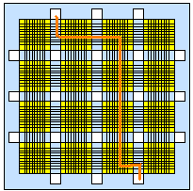
FPGA interconnects- wires
Typically, an FPGA contains a mix of segment lengths:
  Some wires that span only one logic block
  Some wires that span more than one logic block
  Some wires that span the whole chip
If a segment is too short, must traverse many segments to reach your destination
  If a segment is too long, waste routing capacity, extra capacitance: too slow!

Slide 24
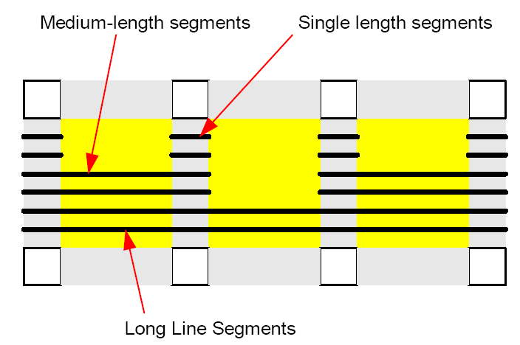
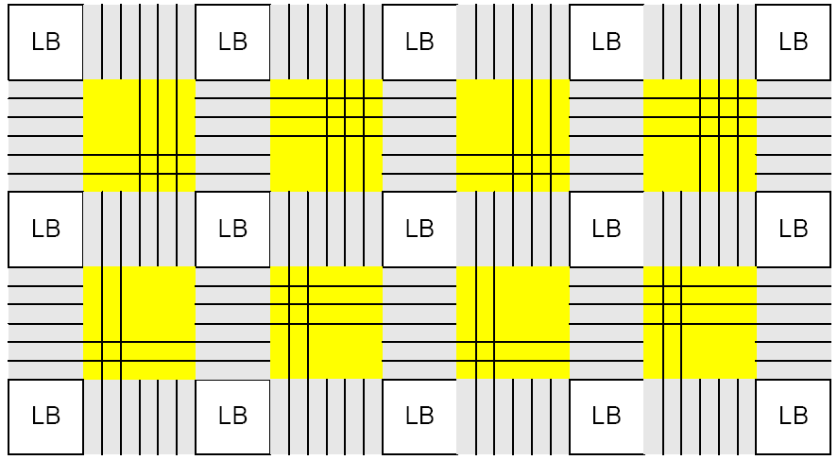
FPGA interconnects- wires
Short segments are good for local connections
Long segments are good for global connections
Most FPGA’s have a variety of segment lengths

Slide 25
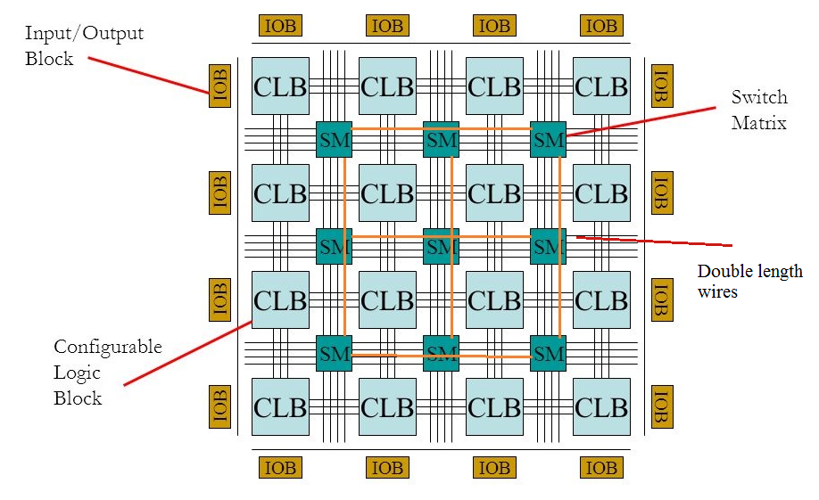
Long wires

Slide 26
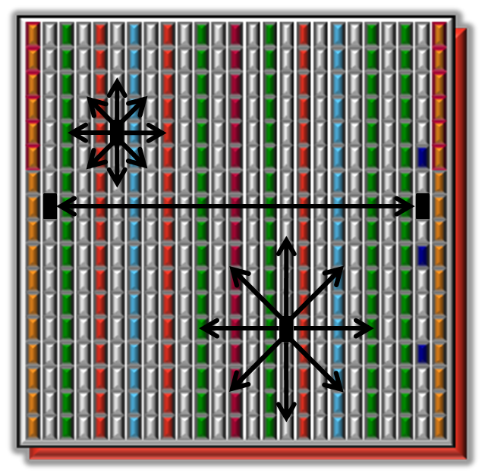
Interconnects in modern FPGAs
Example: Artix-7
Connections between CLBs and other resources use the fabric routing resources
Routes connect resources vertically, horizontally, and diagonally
Wires have different lengths Horizontal: Single, Dual, Quad, Long (12)
  Vertical: Single, Dual, Hex, Long (18)
  Diagonal: Single, Dual, Hex
Notes:
Routing decisions are made by the implementation tools, based upon the timing constraints that have been applied to the design.
The lengths of the vertical and diagonal routing resources has increased from the Virtex-6 family to improve vertical routing capabilities:
Quad lines have become Hex lines.
Long lines have increased from 16 to 18.
The changes in the routing lengths also contribute to substantially improved routability.

Slide 27
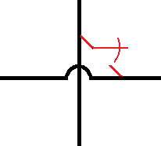
Programming technology
Must use a programmable technology to implement the reconfigurable parts
D7
X
X
X
D6
D5
X
X
D4
X
A
A2
D3
X
D2
X
X
B
A1
D1
A0
D0
X
C
F3
F2
F1
F0

Slide 28
Programmable parts
PAL and PLA connection points
Multiplexers
Interconnects among different components in a programmable chip
Lookup table entries
→ These parts will be introduced soon!

Slide 29
Programming technologies
How the programmable parts are constructed
Three major technologies
  SRAM+ transistor switches
  ROM
  Antifuse

Slide 30
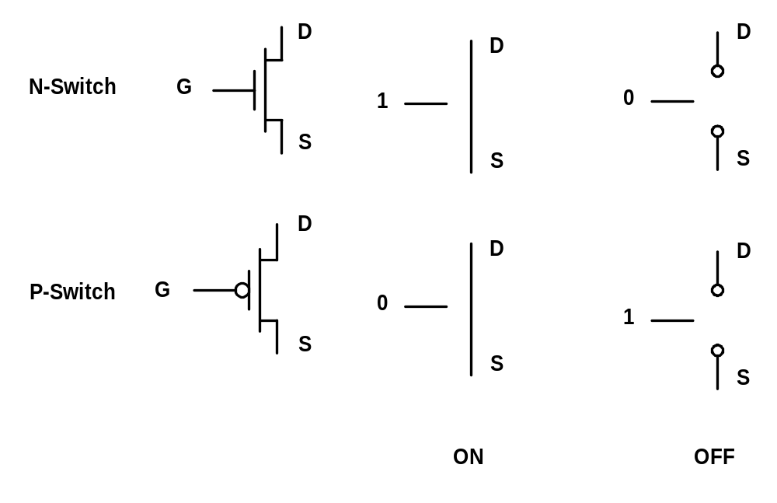
Programming technology- SRAM
Recall the transistor functionality as a switch

Slide 31
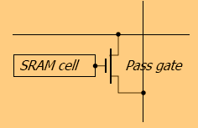
Programming technology- SRAM
The switch should be controlled by some memory element
  To keep the configuration
A Static Random Access Memory (SRAM) is used
  Each switch is a pass transistor controlled by the state of an SRAM bit
  Needs to be configured at power-on
SRAM Bit 0
SRAM Bit 1

Slide 32
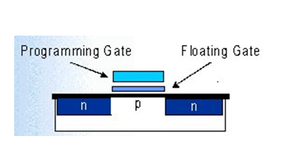
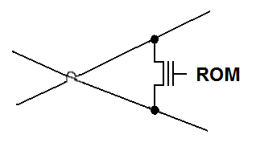
Programming technology- ROM
Flash Erasable Programmable ROM (Flash)
  Device itself holds the program
  Reprogrammable, even in-circuit
  The configuration is kept, even if the circuit is shut down
Wire
Wire
32

Slide 33
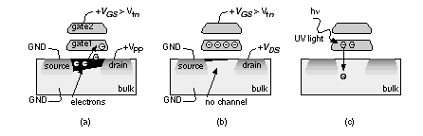
Programming technology- ROM
ROM: a transistor switch has and additional floating-gate
  Can be turned off by injecting negative charge onto the floating gate: negative charge prevent channel formation
  Can be turned on by discharging the floating gate
EPROM: discharging by UV light
EEPROM: discharging by electrical voltage

Slide 34
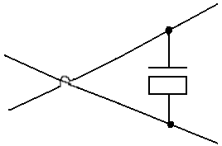

Programming technology- Antifuse
Fusible Links (“Antifuse”)
  Forms a low resistance path when electrically programmed
Lower area and higher speed than SRAM and ROM
Once the fuse is programmed, the state never changes
  One-time programmable
Antifuse
Wire
Wire

Slide 35

FPGA market
Several companies produce FPGAs and CPLDs
Two major companies: Altera (Intel) and Xilinx

